Slide 1



ANALYST BRIEFING FOR THE YEAR ENDED 31 MARCH 2021
VIRTUAL PRESENTATION

Slide 2

AGENDA
WELCOME AND INTRODUCTION
2. TRADING REVIEW
3. FINANCIALS
4. DISCUSSION/QUESTIONS

Slide 3
TRADING ENVIRONMENT
    Pervasive impacts of COVID-19 Pandemic during the year.
      Lockdowns and restrictions on economic and social activities, particularly in Q1 and Q4.
      Periodic closure of on-premise consumption trading channels.
      Constrained disposable incomes particularly for self employed and informal sectors; reduced earnings for most employees.

Slide 4
TRADING ENVIRONMENT – Ctd
    In Zimbabwe
      Introduction of the auction system for forex trading and relaxation of trading in foreign currencies resulting in a relatively stable exchange rate and improved access to forex.
      Cereals deficit resulting in imports reliance.
      Transaction challenges following changes and restrictions on mobile digital payment platforms.
      Heavy rainfall against a poor road infrastructure affected distribution reach.
      In Zambia
      Non enforcement of bulk beer trading laws.
      The decline of the Kwacha exchange rate drove cost pressures on an already fragile economy.
      In South Africa
      The total ban of alcohol from the date we took over UNB resulting in compromised cash flows and earnings.

Slide 5
KEY DEVELOPMENTS DURING THE YEAR
    Acquisition of UNB (RSA). Unit caught up in alcohol bans and Covid-19 restrictions.
    Extension of the Coca-Cola franchise territory to include Manicaland – effective end of March 2021.
    Zambia National Breweries trading difficulties needing shareholder support.
    Leadership changes.

Slide 6
VOLUME PERFORMANCE SUMMARY
Category | Actual Volume 000hl | % Change on Prior year
1. BEVERAGES (HLS 000) | F21 | F20
Lager Beer
1.1 Clear Beer | 1 354 | 17
Sorghum Beer
1.2 Sorghum Beer - Zimbabwe | 2 603 | (7)
1.3 Sorghum Beer -Zambia | 816 | 6
1.4 Sorghum Beer -South Africa | 802 | (37)
Soft Drinks
1.5 Sparkling Beverages | 877 | 33
1.6 Alternative Beverages | 59 | (27)
Wines and Spirits
1.7 African Distillers | 98 | 31
Total excluding Associates | 6 609 | (3)
Associates
1.8 Schweppes Zimbabwe Limited | 652 | (1)
Total Beverages incl Associates | 7 261 | (3)

Slide 7
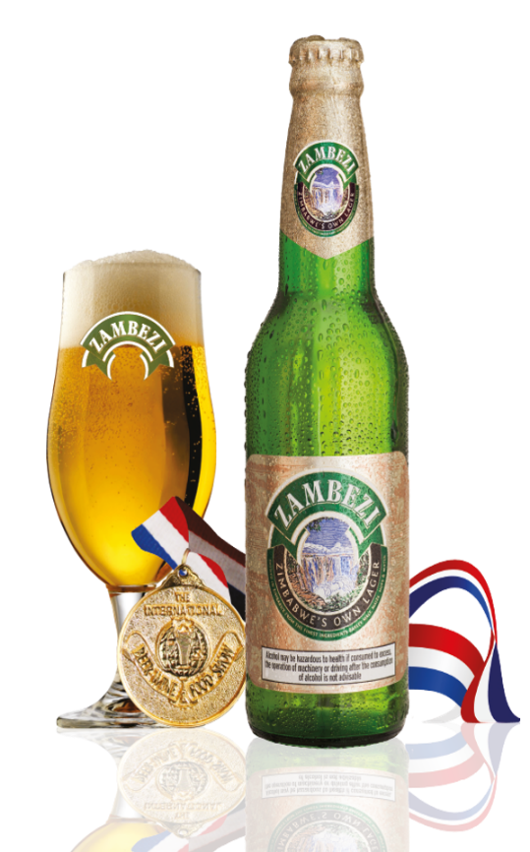
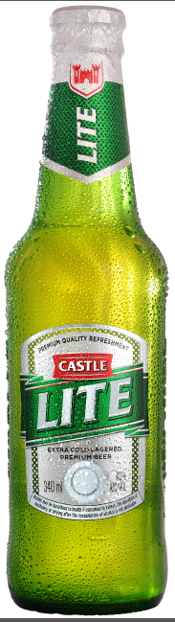
LAGER BEER
  Volume performance was affected by Covid-19 restriction due to limited social activities, reduced consumption occasions and a ban of on-premise consumption channels.
  Limited spend on returnable glass bottles since 2016. We are now prioritizing investment in returnable containers to address market supply challenges and achieve full supply of all brands and packs.
  We hold sufficient barley stocks and pressure on imported inputs has eased as forex availability improved.
  Competitive and affordable pricing drove volume recovery while containing the distorted value chain costs.

Slide 8
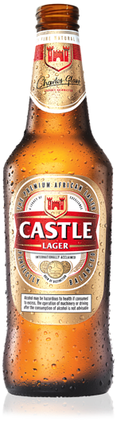
LAGER BEER 5 YEAR VOLUME PERFOMANCE

Slide 9
TRADING REVIEW - LAGER BEER MIX
HLs ‘000

Slide 10
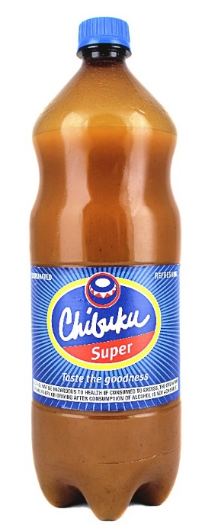
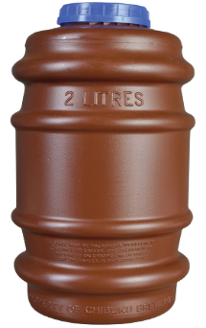
SORGHUM BEER
  Zimbabwe (Down 7%)
  The Covid-19 restrictions constrained volume performance as trade channels and market access were limited.
  Distribution to the rural and peri-urban markets were affected by the poor road infrastructure which posed challenges during the rain season.
  Mix was in favour of Chibuku Super in line with our strategy but was also driven by the ban of on- premise consumption which limited the uptake of the short life returnable scud pack.
  The business relied on imported cereals and should benefit from an improved agricultural season in F22.
  Zambia (Up 6%)
  Nascent volume recovery driven by the temporal closure of illegal bulk brewers at the onset of Covid- 19 lockdowns.
  The business needs working capital support in the short to medium term while rolling out strategies to trade back to sustainable levels.
  South Africa (Down 37%)
  The business did not trade for most of the year due to Covid-19 ban on alcohol trading.

Slide 11
SORGHUM ZIMBABWE BEER 5 YEAR VOLUME PERFORMANCE

Slide 12
TRADING REVIEW - SORGHUM BEER (ZIMBABWE) MIX
HLs ‘000

Slide 13
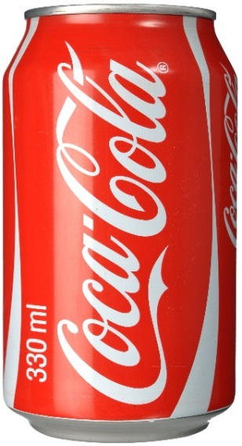
SPARKLING BEVERAGES
  Sector was significantly impacted by limited social and economic activity under the Covid-19 restrictions which reduced consumption occasions.
  Recovered both volume and market share following better foreign currency availability for imported inputs.
  Increase in take-home packs driven by supermarket channels during Covid-19. Injecting glass to support competitiveness drive.
  Disruptions to supply in Q4 due to shortages of sugar and carbon dioxide.
  On boarded the Manicaland territory at the end of March 2021.

Slide 14

SPARKLING BEVERAGES 5 YEAR VOLUME

Slide 15
TRADING REVIEW - SPARKLING BEVERAGES MIX
HLs ‘000

Slide 16
AFRICAN DISTILLERS VOLUME PERFORMANCE
 | Actual Volume 000litres | % Change on Prior Year
1. BEVERAGES (Litres 000)
1.1 Spirits | 53 617 | 41
1.2 Wines | 3 841 | (49)
1.3 Ciders | 40 974 | 37
Total | 98 432 | 31
  Volume recovery on improved product supply, expanded distribution channels to general trade and better foreign currency availability.
  Focus on product innovations driving competitiveness and price access points.
  Wines affected by closure of restaurants and hotel channel.

Slide 17


UPDATE ON ASSOCIATES
  Schweppes Zimbabwe Limited
    Improved supply of Mazoe orange crush and Fruitrade brands.
    Relaunch of Minute Maid juice drinks. New flavours added.
    Improved juicing fruit intake to support volume growth ambitions.
  Nampak Zimbabwe
    Benefiting from improved orders from upstream customers.
    Ongoing drive to improve export performance against challenging
    value chain costs which affect competitiveness.

Slide 18
SCHWEPPES ZIMBABWE LIMITED 5 YEAR VOLUME PERFOMANCE
Hls 000

Slide 19


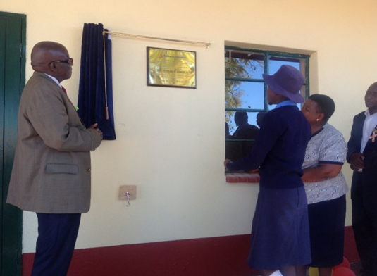
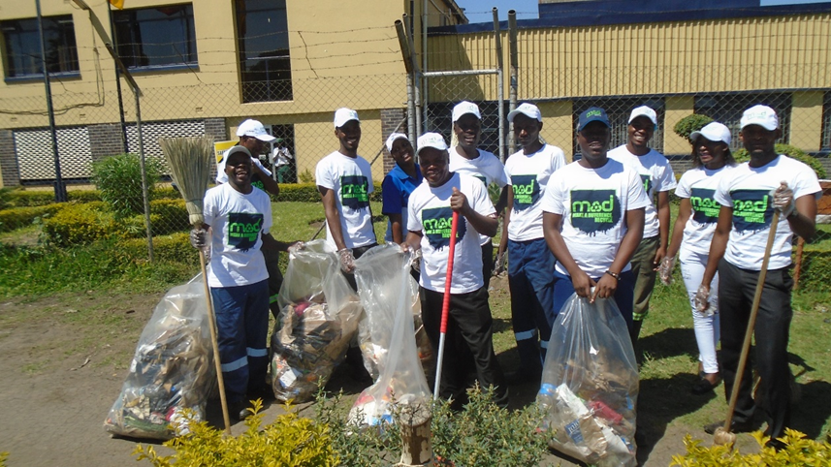






OUR SUSTAINABILITY APPROACH
We embrace the World Health Organisation’s Sustainable Development Challenges in all our endeavours
Our businesses remains focused on the 5 Sustainability pillars:
WORKPLACE SAFETY
We are consumers of water in our breweries and bottling plants and we commit to using the water resource sparingly. We aim to brew our beers at the highest level of water efficiency and have set ambitious targets across our business.
We will work collaboratively with value chain partners and environmental agencies to ensure we reduce our carbon emissions along the value chain.
We will continue investing in returnable packs and support recycling initiatives of our PET, non- returnable bottles and cans. Our MAD campaign on litter management has been scaled up.
The health and safety of our colleagues is always our top priority. We adhere to high standards of health and safety in workplaces and throughout our value chain. The Covid-19 pandemic presented new challenges
We work with 11,500 direct farmers to procure our barley, sorghum and maize used to manufacture our fine beverages.

Slide 20
FINANCIAL HIGHLIGHTS
INFLATION ADJUSTED INFORMATION |  |  |  |  |  |  |  |  | HISTORICAL COST INFORMATION
 | Revenue |  |  |  |  |  |  |  |  | Revenue
Increased by 39% to ZW$ 40,45 billion |  |  |  |  |  |  |  |  | Increased by 692% to ZW$ 33,21 billion
Operating Income |  |  |  |  |  |  |  |  | Operating Income
 | Increased by 47% to ZW$ 10,71 billion |  |  |  |  |  |  |  |  | Increased by 557% to ZW$ 8,65 billion
Dividend per share |  |  |  |  |  |  |  |  | Dividend per share
 | Interim dividend declared - ZW$ 45,00 cents |  |  |  |  |  |  |  |  | Interim dividend declared - ZW$ 45,00 cents
 | Final dividend declared - ZW$ 105,00 cents |  |  |  |  |  |  |  |  | Final dividend declared - ZW$ 105,00 cents

Slide 21
SEGMENT REVENUE – HISTORICAL COST
 |  | March 2021 |  | March 2020
 |  | Revenue | Revenue Contri. % | Revenue | Revenue Contri. % | % to Prior Year
Lager Beer |  | 13 130 869 | 40 | 1 692 416 | 40 | 676
Sparkling Beverages |  | 4 556 957 | 14 | 677 536 | 16 | 573
Sorghum Business |  | 12 552 367 | 38 | 1 498 264 | 36 | 738
Wines and Spirits |  | 2 710 990 | 8 | 319 265 | 8 | 749
Total Reportable Segments |  | 32 951 183 | 99 | 4 187 481 | 100 | 687
All other segments |  | 255 101 | 1 | 5 779 | 0 | 4 314
Total Revenue |  | 33 206 284 | 100 | 4 193 260 | 100 | 692

Slide 22
OUTLOOK
    Business and consumers are adjusting to living with and under Covid-19 conditions.
    In Zimbabwe
    Improved economic activity driven by food security.
    Increased disposable income riding on a good agricultural season.
    Better access to foreign currency for inputs and debt service.
    Increased mining activities to drive consumer spending.
    To direct capital investment to rebuilding returnable containers to enable full market supply.
    Economic stability dependent on continued sustainable management of fiscal and monetary policies
    In Zambia – focus will be to support the business on market recovery and improved earnings performance.
    In South Africa the focus is on the relaunch of our brands to recover volume and mitigate effects of extended alcohol bans.

Slide 23


